Slide 1

System Design & Analysis
Team 3 Final Phase
5.12.2025

Slide 2
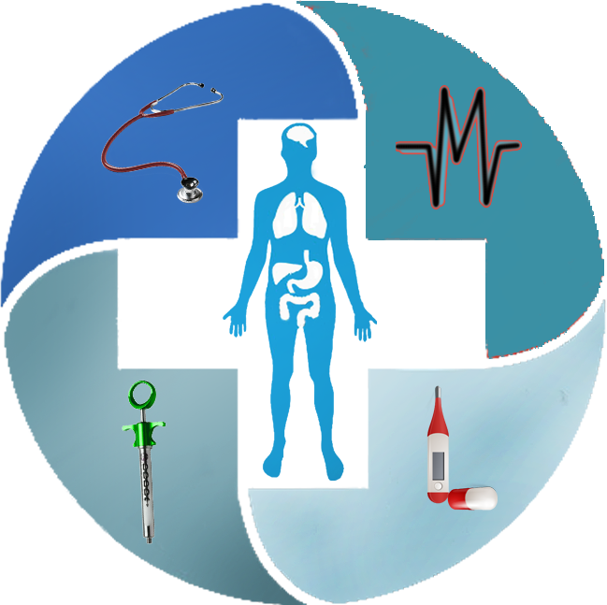
“The Greatest wealth is health.”
HealthPal
A comprehensive app designed to help users keep track of their vital health metrics, set wellness goals, and receive data-driven personalized recommendations at their fingertips. By keeping track of health metrics, users can make informed decisions that positively impact their overall health and quality of life.
This Photo by Unknown Author is licensed under CC BY

Slide 3

HealthPal-Your Partner in wellness
HealthPal is a friendly companion for managing and improving health. The app is designed as a “pal” or partner, simplifying the user’s journey toward a healthy lifestyle. HealthPal empowers users by making health management intuitive and accessible, just like a trusted friend who always supports and guides you.
This Photo by Unknown Author is licensed under CC BY-ND

Slide 4
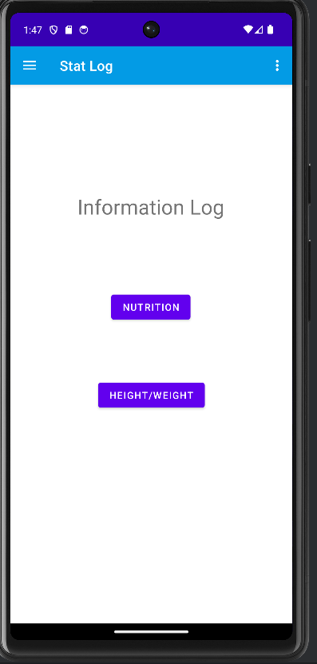
Information Log
This is the screen for logging information. Users choose the type of information they wish to input and are then directed to the appropriate logging interface.

Slide 5
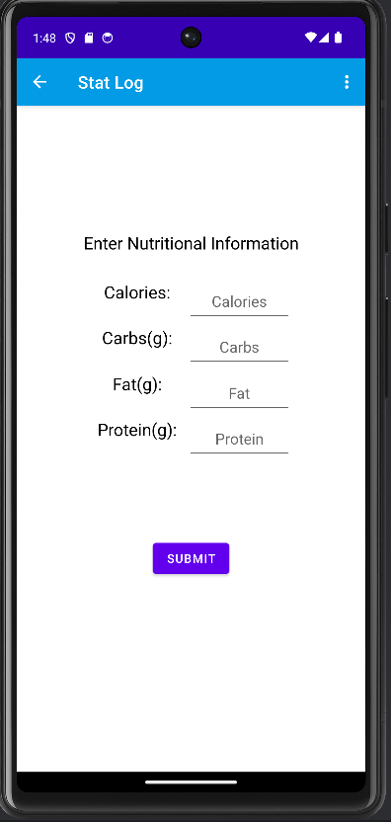
Nutrients Log
This section of the app allows users to input their nutrient information, which is then stored in the database

Slide 6
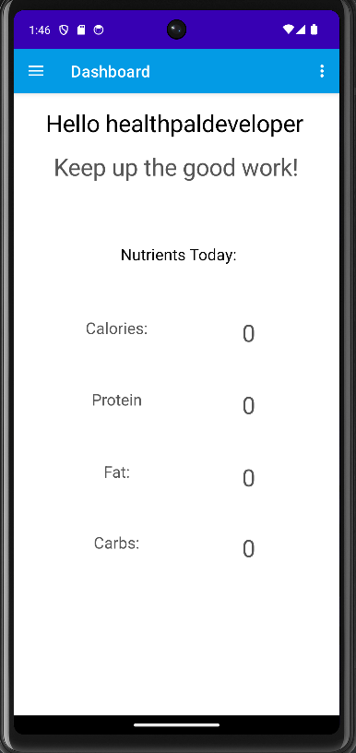
Dashboard
The dashboard provides users with real-time update on their metric. It welcomes the user and displays a motivational message to help them stay inspired .

Slide 7
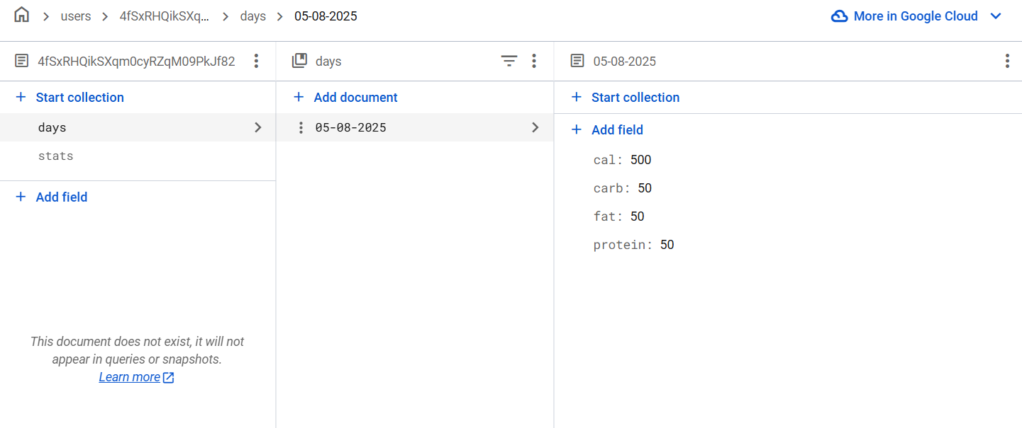
Database

Slide 8

Technology: hardware & software
HEALTHPAL
Android Studio
Android Mobile Device
GitHub
Google Authentication API
Gemini AI
Firebase
SQL
Java

Slide 9
Team 3 Final Presentation
Live Demo

